Slide 1
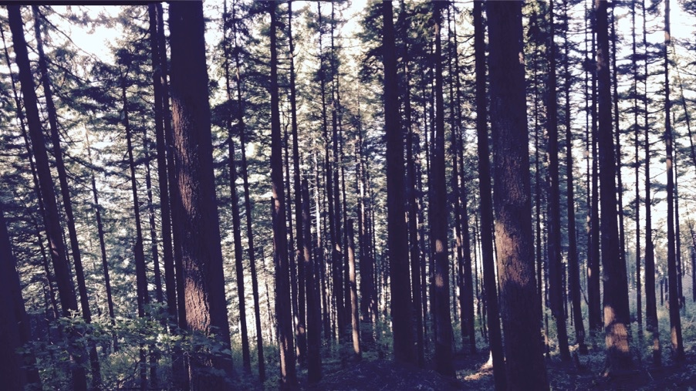
Plants aren’t dumb Using optimality theory to understand big questions in plant ecophysiology
Nick Smith
Department of Biological Sciences
Texas Tech University
nick.smith@ttu.edu; @nick_greg_smith

Slide 2
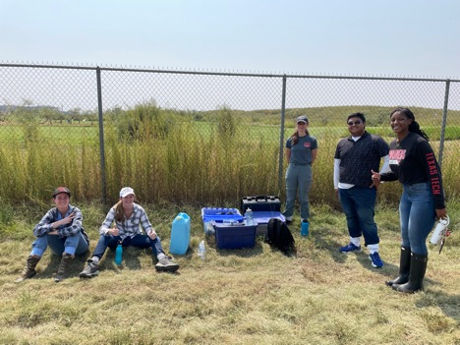
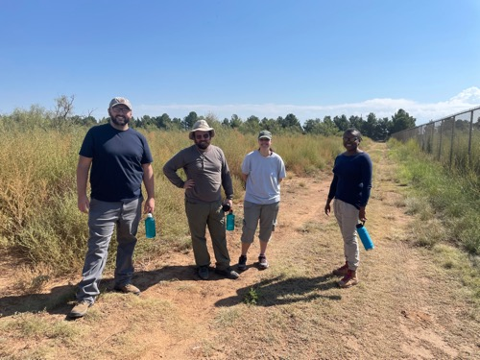
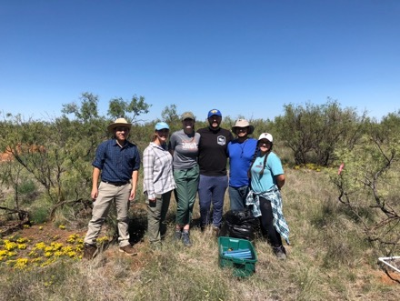
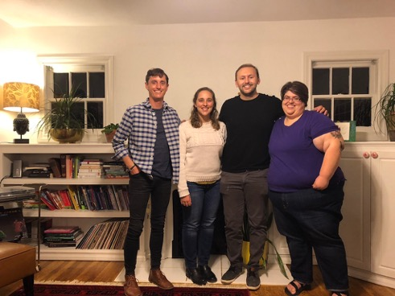





Acknowledgements
nick.smith@ttu.edu; @nick_greg_smith
Current lab members
Jeff Chieppa (postdoc)
Brad Posch (postdoc)
Evan Perkowski (PhD student)
Zinny Ezekannagha (PhD student)
Risa McNellis (MS; now lab tech)
Morgan Appell (undergrad)
Joseph Terrones (undergrad)
Former lab members
Lizz Waring (postdoc; now Asst. Prof at Northeastern State U)
Helen Scott (MS; now in industry and PhD student at BU)
Jorge Ochoa (undergrad; now working for the Army)
Jose Villeda (undergrad; now in industry)
Leah Ortiz (undergrad; now in industry)
Collaborators at TTU and around the world
Funding
NSF
USDA
NPS
USGS
Schmidt Futures

Slide 3
Why do people care about plants?
nick.smith@ttu.edu; @nick_greg_smith

Slide 4
Why do people care about plants?
nick.smith@ttu.edu; @nick_greg_smith

Slide 5
Why do people care about plants?
nick.smith@ttu.edu; @nick_greg_smith

Slide 6
Why do people care about plants?
nick.smith@ttu.edu; @nick_greg_smith

Slide 7
Why do people care about plants?
nick.smith@ttu.edu; @nick_greg_smith

Slide 8
Why do people care about plants?
nick.smith@ttu.edu; @nick_greg_smith

Slide 9
Why do people care about plants?
nick.smith@ttu.edu; @nick_greg_smith

Slide 10
Why do people care about plants?
nick.smith@ttu.edu; @nick_greg_smith

Slide 11
Why do people care about plants?
nick.smith@ttu.edu; @nick_greg_smith

Slide 12
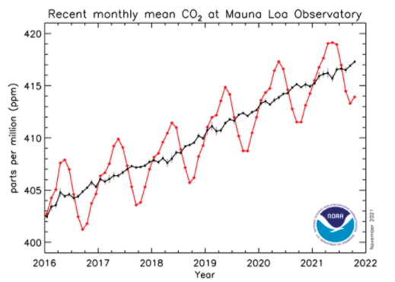
Why do people care about plants?
nick.smith@ttu.edu; @nick_greg_smith

Slide 13
In other words: plants provide ecosystem services
nick.smith@ttu.edu; @nick_greg_smith
FNAL

Slide 14
Including photosynthesis
nick.smith@ttu.edu; @nick_greg_smith
FNAL

Slide 15
Photosynthesis provides the foundation for other services
nick.smith@ttu.edu; @nick_greg_smith
FNAL

Slide 16
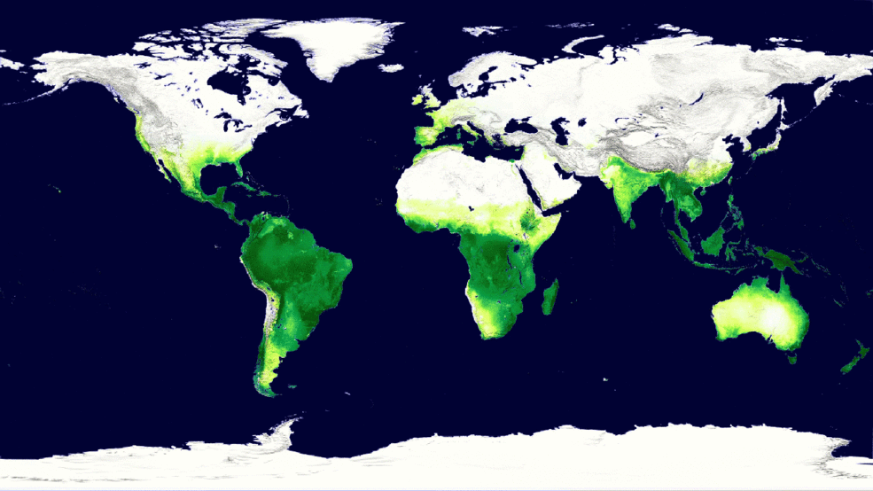
Photosynthesis is a dynamic process
nick.smith@ttu.edu; @nick_greg_smith
MODIS, NASA

Slide 17
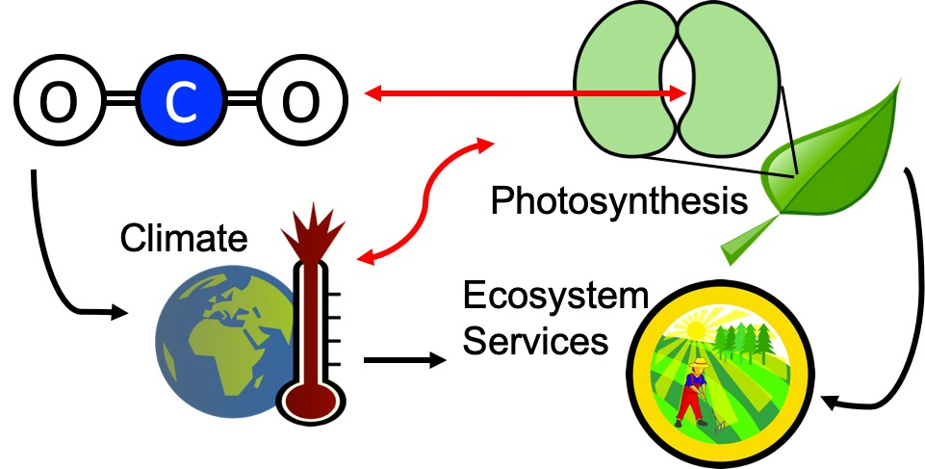
Our lab examines photosynthesis as a regulator of global change impacts on ecosystem services
nick.smith@ttu.edu; @nick_greg_smith

Slide 18
Photosynthesis is important! An example…
nick.smith@ttu.edu; @nick_greg_smith

Slide 19
Photosynthesis is important! An example…
nick.smith@ttu.edu; @nick_greg_smith
Data from IPCC (2013)

Slide 20
Photosynthesis is important! An example…
nick.smith@ttu.edu; @nick_greg_smith
Photosynthesis
Data from IPCC (2013)

Slide 21
Photosynthesis is important! An example…
nick.smith@ttu.edu; @nick_greg_smith
Photosynthesis
A small percentage change in photosynthesis can have large consequences for climate
Data from IPCC (2013)

Slide 22
But predictions are uncertain!
nick.smith@ttu.edu; @nick_greg_smith
Friedlingstein et al. (2014)

Slide 23
But predictions are uncertain!
nick.smith@ttu.edu; @nick_greg_smith
Future model uncertainty (14 Pg) > current fossil fuel emissions (9.5 Pg)
Friedlingstein et al. (2014)

Slide 24
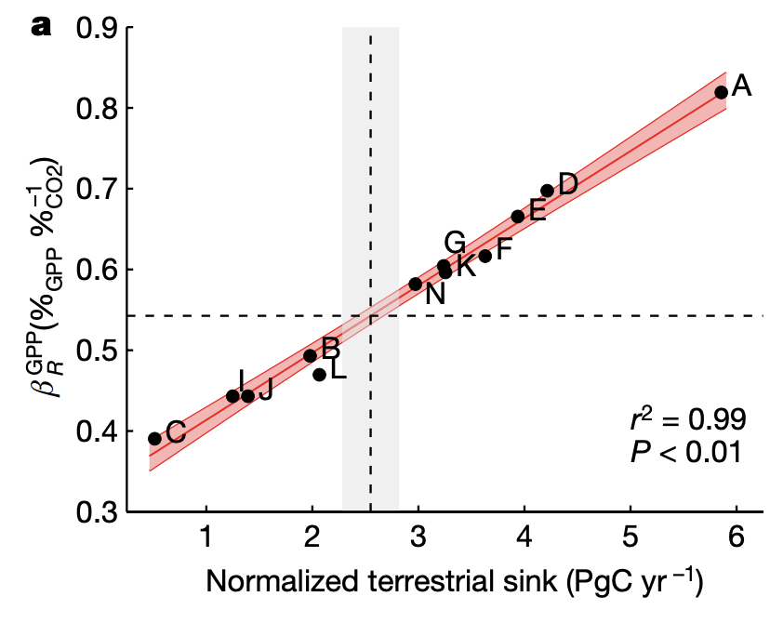
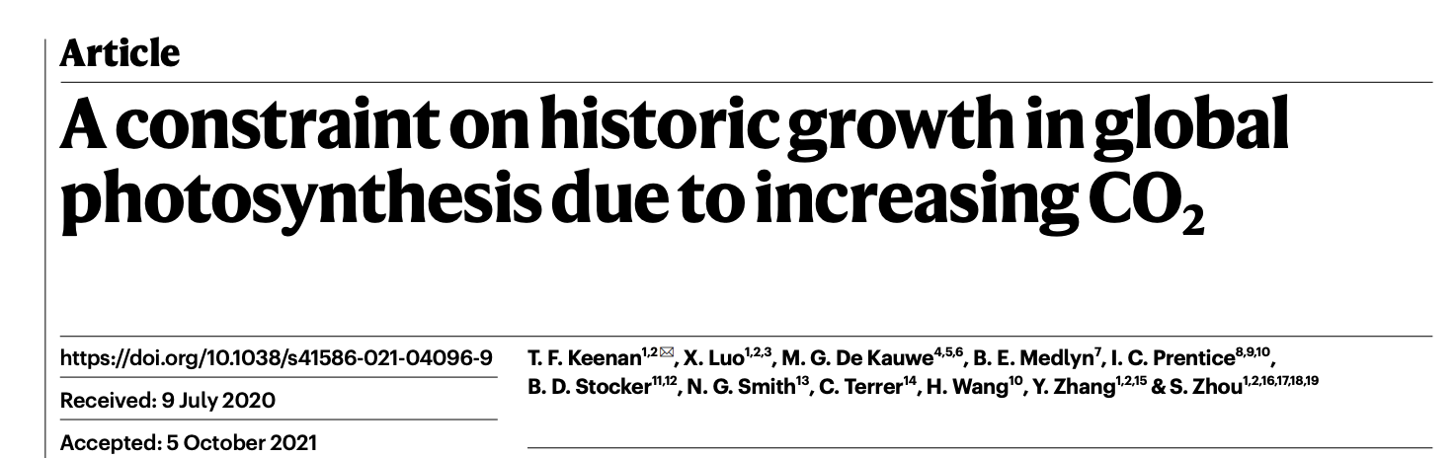
This uncertainty is driven by uncertainty in photosynthesis
nick.smith@ttu.edu; @nick_greg_smith
Friedlingstein et al. (2014)
Keenan et al. (2021)

Slide 25
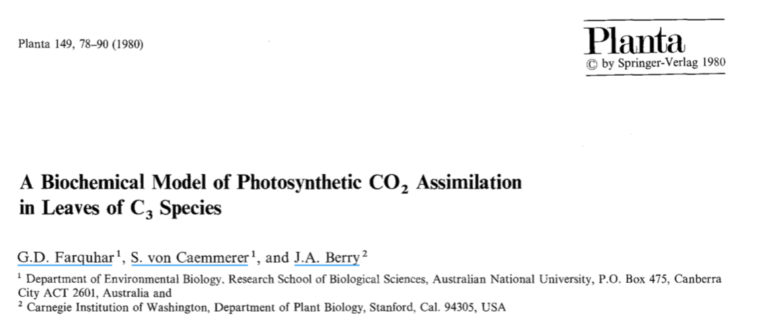
Why the uncertainty? Theoretical models for photosynthesis exist
nick.smith@ttu.edu; @nick_greg_smith

Slide 26
These produce short term responses that match data
nick.smith@ttu.edu; @nick_greg_smith

Slide 27
Why the uncertainty? Long-term responses differ from short-term responses due to acclimation
nick.smith@ttu.edu; @nick_greg_smith

Slide 28
nick.smith@ttu.edu; @nick_greg_smith
Dumb plants

Slide 29
nick.smith@ttu.edu; @nick_greg_smith
Acclimated to high light
Acclimated to low light

Slide 30
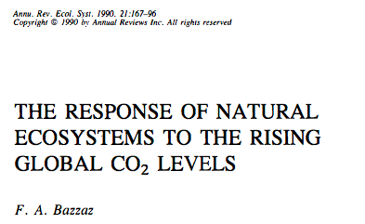
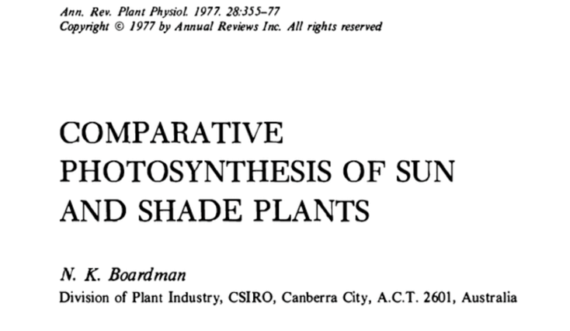
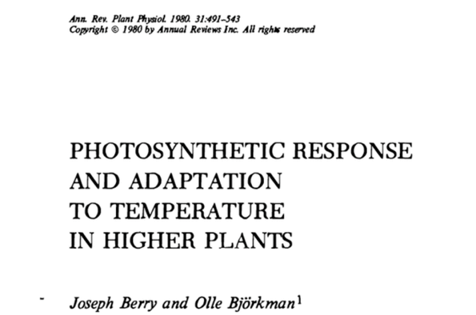
Acclimation is ubiquitous and well known…
nick.smith@ttu.edu; @nick_greg_smith
Temperature: Berry & Björkman (1980)
CO₂: Bazzaz (1990)
Light: Boardman (1977)

Slide 31
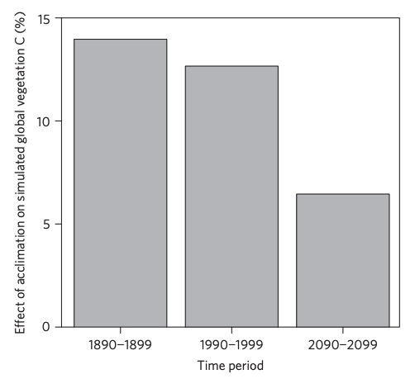
…and can impact carbon cycling and climate
nick.smith@ttu.edu; @nick_greg_smith
Acclimation increase future C storage by ~6%
Acclimation alters future temperature by >1°C
Smith et al. (2017) Nature Climate Change
Smith et al. (2017) JAMES

Slide 32
Unfortunately, no theoretical model for photosynthetic acclimation exists
nick.smith@ttu.edu; @nick_greg_smith

Slide 33
Lack of theory results in…
nick.smith@ttu.edu; @nick_greg_smith

Slide 34
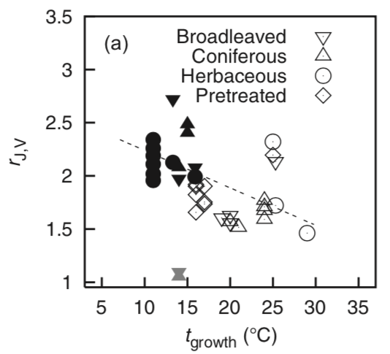
Lack of theory results in…
nick.smith@ttu.edu; @nick_greg_smith
Unreliable future predictions (overparameterization, tuning)
Reliance on statistical models
Resulting change in simulated photosynthesis
Physiological parameter
Environmental condition
Kattge and Knorr (2007) PC&E
Smith et al. (2017) JAMES

Slide 35
Lack of theory results in…
nick.smith@ttu.edu; @nick_greg_smith
Inability to test mechanisms
Resulting change in simulated photosynthesis
Physiological parameter
Environmental condition
Kattge and Knorr (2007) PC&E
Smith et al. (2017) JAMES

Slide 36
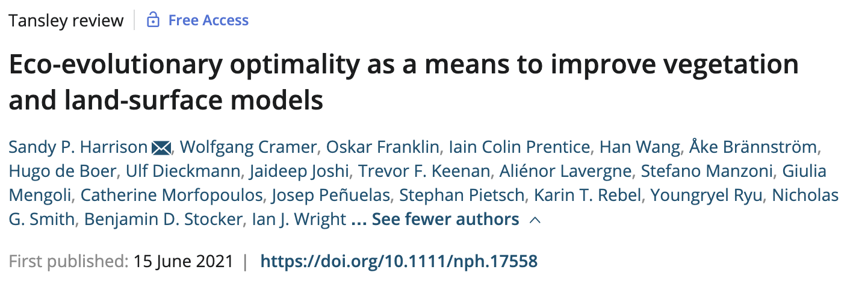
So, we developed a mechanistic model of photosynthetic acclimation Based on optimization and the first principles of plant physiological theory
nick.smith@ttu.edu; @nick_greg_smith

Slide 37
Optimization: Least cost theory
nick.smith@ttu.edu; @nick_greg_smith
Optimally, plants will maintain fastest rate of photosynthesis at the lowest summed resource cost (water and nutrient use)
Wright et al. (2003)

Slide 38
Optimal photosynthesis
nick.smith@ttu.edu; @nick_greg_smith
Photosynthesis = f{stomatal conductance,
photosynthetic biochemistry}

Slide 39
Optimal photosynthesis
nick.smith@ttu.edu; @nick_greg_smith
Photosynthesis = f{stomatal conductance,
photosynthetic biochemistry}
Must predict optimal rates of both

Slide 40
Optimal photosynthesis
nick.smith@ttu.edu; @nick_greg_smith
Photosynthesis = f{stomatal conductance,
photosynthetic biochemistry}
[TALK TO ME LATER ABOUT THIS IF YOU ARE INTERESTED]
Prentice et al. (2014); Wang et al. (2017); Smith et al. (2019)

Slide 41
Optimal photosynthesis
nick.smith@ttu.edu; @nick_greg_smith
Photosynthesis = f{stomatal conductance,
photosynthetic biochemistry}

Slide 42
Biochemistry optimization
nick.smith@ttu.edu; @nick_greg_smith
Plant biochemistry setup will aim for equal limitation by all factors
[TALK TO ME LATER ABOUT THE MATHS]

Slide 43
Biochemistry trait The maximum rate of Rubisco carboxylation (V_{cmax})

Slide 44
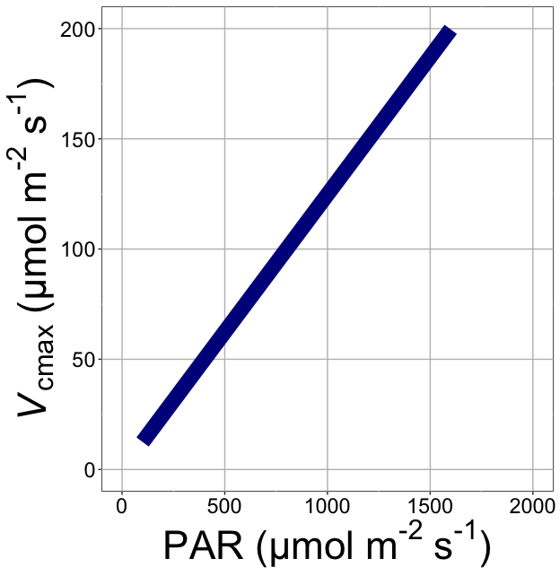
nick.smith@ttu.edu; @nick_greg_smith
V_{cmax} increases with light because of greater electron transport
Smith et al. (2019)

Slide 45
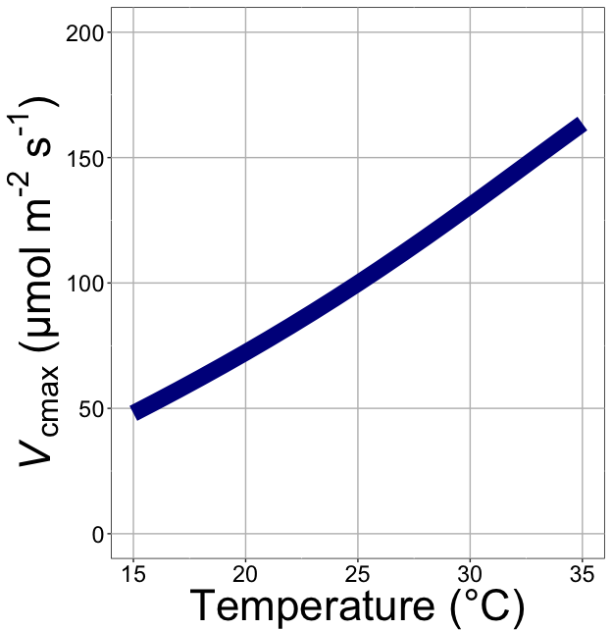
nick.smith@ttu.edu; @nick_greg_smith
V_{cmax} increases with temperature because of greater electron transport and photorespiration
Smith et al. (2019)

Slide 46
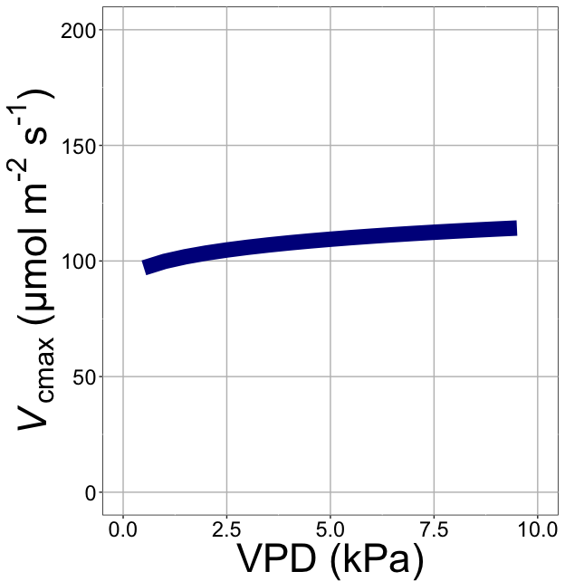
nick.smith@ttu.edu; @nick_greg_smith
V_{cmax} increases with VPD because of lower stomatal conductance
Smith et al. (2019)

Slide 47
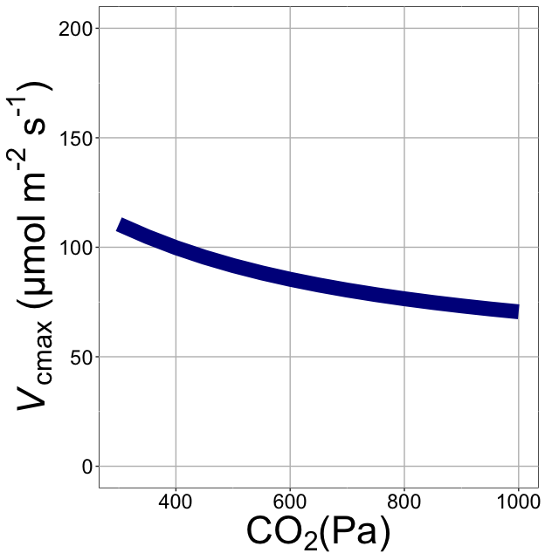
nick.smith@ttu.edu; @nick_greg_smith
V_{cmax} decreases with CO₂ because of greater CO₂ in the leaf
Smith et al. (2019)

Slide 48
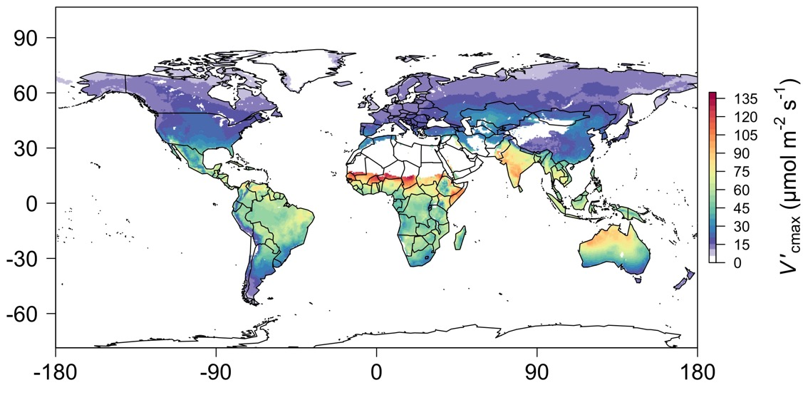
nick.smith@ttu.edu; @nick_greg_smith
We can predict optimal traits in different environments
Smith et al. (2019)

Slide 49
Ok, great, but now what?
nick.smith@ttu.edu; @nick_greg_smith

Slide 50
We can use the theory as a null model to explore acclimation mechanisms
nick.smith@ttu.edu; @nick_greg_smith

Slide 51
Let’s tackle some big questions in plant ecophysiology!
nick.smith@ttu.edu; @nick_greg_smith

Slide 52
Big questions
Is photosynthesis optimized to the environment?
Does photosynthesis acclimate to soil nutrients?
What does acclimation mean for future terrestrial biogeochemical cycling?
When is C₄ photosynthesis an advantage over C₃ photosynthesis?

Slide 53
Question 1: Is photosynthesis optimized to the environment?
nick.smith@ttu.edu; @nick_greg_smith

Slide 54
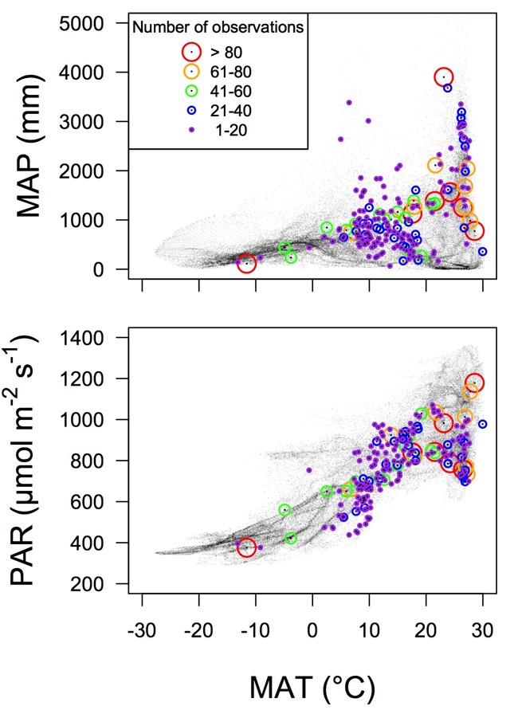
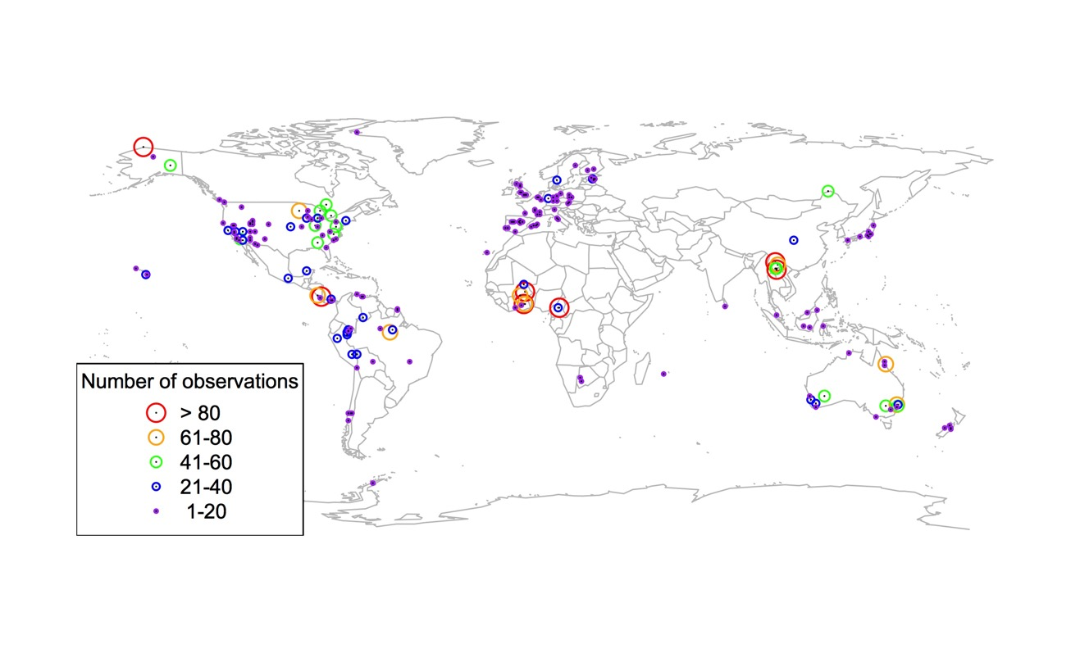
Global V_{cmax} dataset
nick.smith@ttu.edu; @nick_greg_smith
3,697 measurements
202 sites
> 600 genera
Smith et al. (2019)

Slide 55

nick.smith@ttu.edu; @nick_greg_smith
Smith et al. (2019)

Slide 56
nick.smith@ttu.edu; @nick_greg_smith
Optimal V_{cmax} is similar to observed values
Smith et al. (2019)

Slide 57
Question 1: Is photosynthesis optimized to the environment? YES! Photosynthesis acclimates spatially as expected from optimization
nick.smith@ttu.edu; @nick_greg_smith

Slide 58
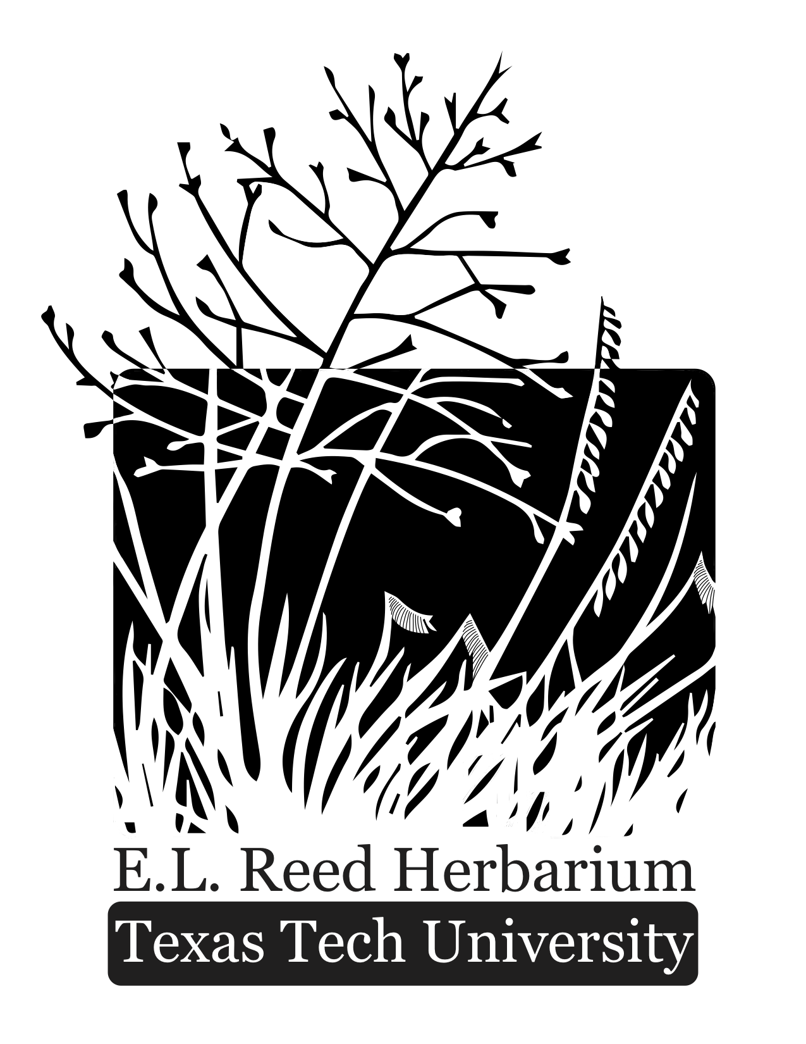
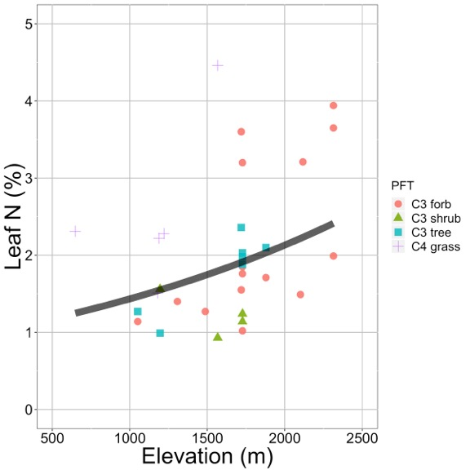
Looking forward: herbarium specimens to examine acclimation over space and time
nick.smith@ttu.edu; @nick_greg_smith
Plants increased leaf N investment with elevation. This response was predicted by acclimation theory.
Villeda et al. (in prep)

Slide 59
Question 2: Does photosynthesis acclimate to soil nutrients?
nick.smith@ttu.edu; @nick_greg_smith

Slide 60
From the least cost hypothesis…
nick.smith@ttu.edu; @nick_greg_smith
Added nutrients will not increase photosynthesis because light limitation will kick in

Slide 61
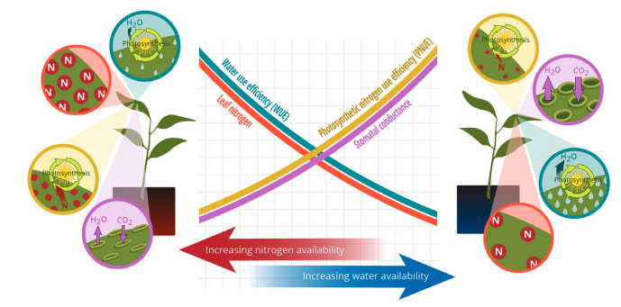
From the least cost hypothesis…
nick.smith@ttu.edu; @nick_greg_smith
Bialic-Murphy et al. (2021)

Slide 62
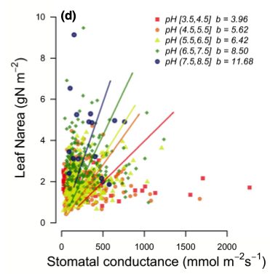
Observations show support for least cost
nick.smith@ttu.edu; @nick_greg_smith
Paillassa et al. (2020)

Slide 63
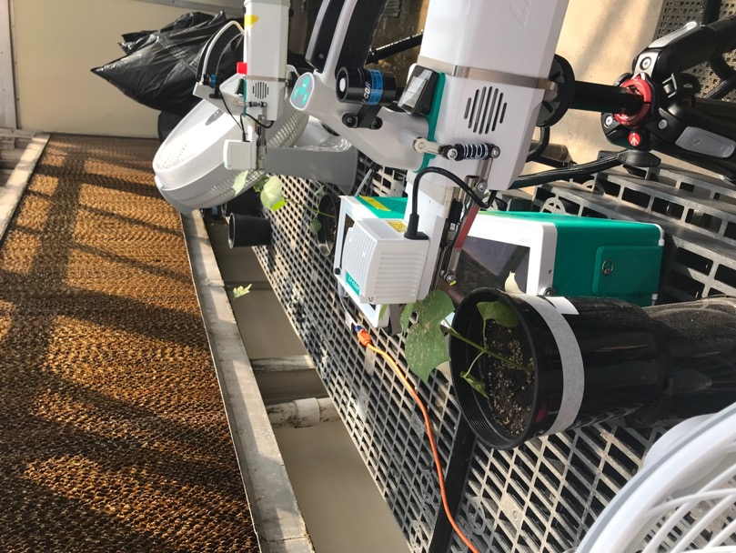
As do greenhouse experiments
nick.smith@ttu.edu; @nick_greg_smith
Waring and Smith (in prep)

Slide 64
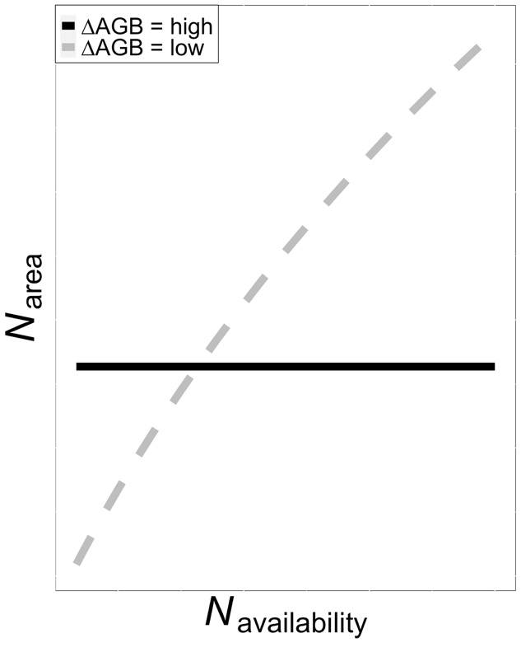
Is plant allocation to leaf N dependent on allocation to biomass?
nick.smith@ttu.edu; @nick_greg_smith

Slide 65
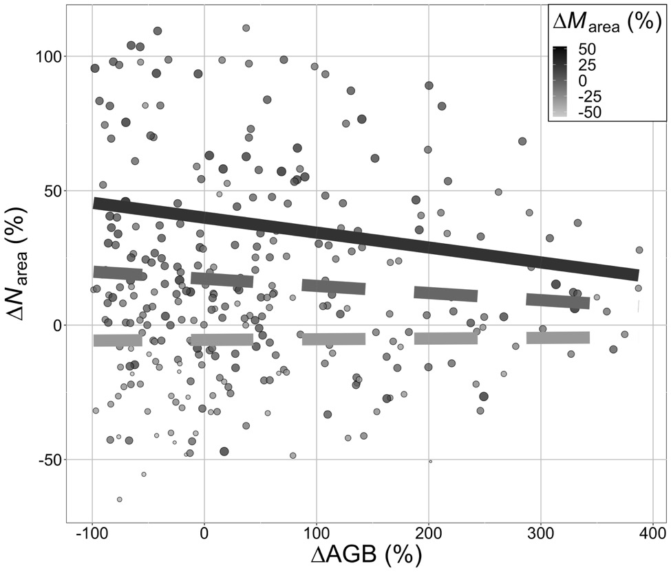
Is plant allocation to leaf N dependent on allocation to biomass?
nick.smith@ttu.edu; @nick_greg_smith
Smith et al. (in prep)

Slide 66
To see a leaf N response to soil N there must be (1) added investment to leaves and (2) small investment to biomass
nick.smith@ttu.edu; @nick_greg_smith
Smith et al. (in prep)

Slide 67
Question 2: Does photosynthesis acclimate to soil nutrients? Yes, although this is dependent on whole-plant allocation decisions
nick.smith@ttu.edu; @nick_greg_smith

Slide 68
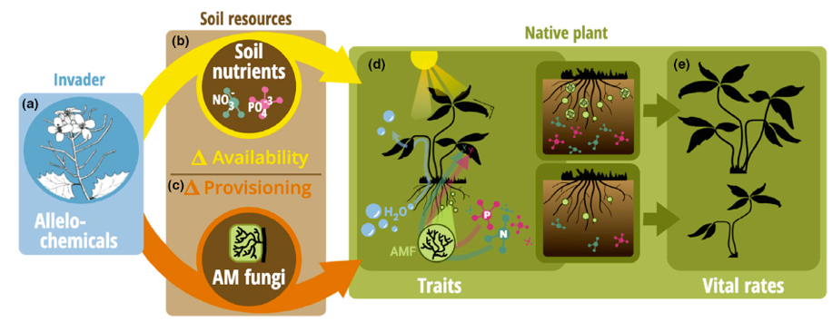
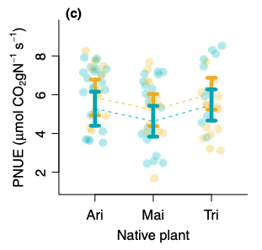
Looking forward: impact of allelopathic invaders on leaf economics
nick.smith@ttu.edu; @nick_greg_smith
Allelopathic invasion (gold) increased photosynthetic N use efficiency of native plants. This response was predicted by acclimation theory.
Bialic-Murphy et al. (2021)

Slide 69

Question 3: What does acclimation mean for future terrestrial biogeochemical cycling?
nick.smith@ttu.edu; @nick_greg_smith

Slide 70
Expected future responses
nick.smith@ttu.edu; @nick_greg_smith

Slide 71
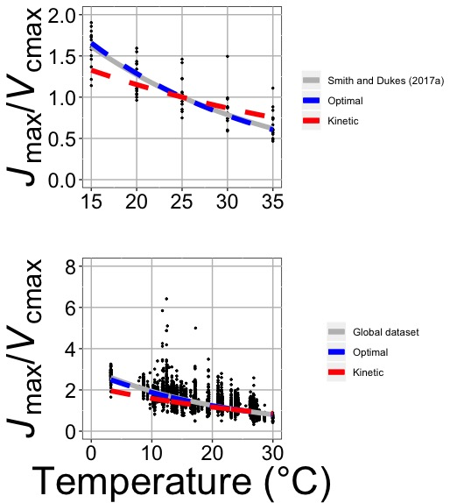
nick.smith@ttu.edu; @nick_greg_smith
Smith and Keenan (2020)

Slide 72
Photosynthetic traits change with temperature in ways expected from optimization
nick.smith@ttu.edu; @nick_greg_smith
Data = -0.051 °C⁻¹
Predicted = -0.048 °C⁻¹
Smith and Keenan (2020)

Slide 73
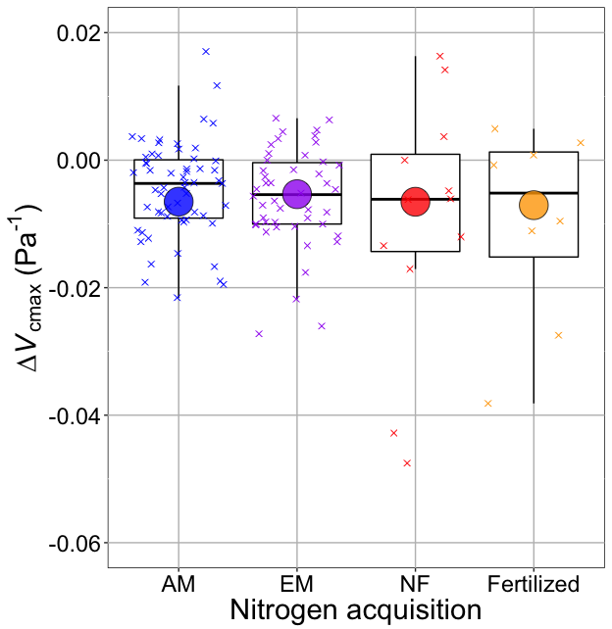
nick.smith@ttu.edu; @nick_greg_smith
Smith and Keenan (2020)

Slide 74
V_{cmax} changes with CO₂ in ways expected from optimization
nick.smith@ttu.edu; @nick_greg_smith
Boxes = data = -0.0063 Pa⁻¹
Circles = predicted = -0.0066 Pa⁻¹
Smith and Keenan (2020)

Slide 75
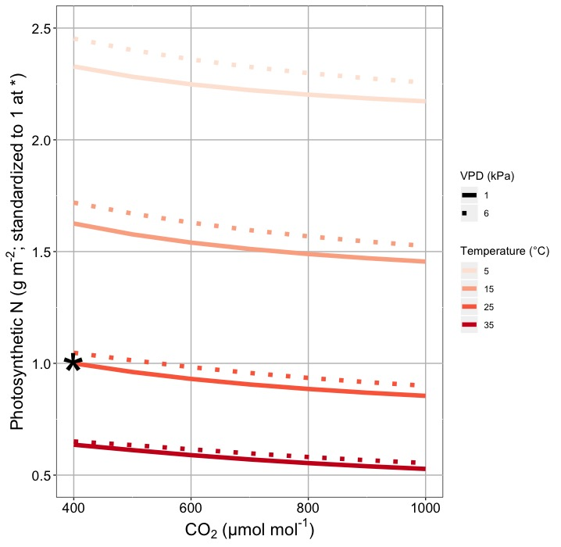
This generally suggests lower nitrogen demand under warmer, high CO₂ conditions
nick.smith@ttu.edu; @nick_greg_smith
Smith and Keenan (2020)

Slide 76
Let’s run a model out into the future!
nick.smith@ttu.edu; @nick_greg_smith

Slide 77
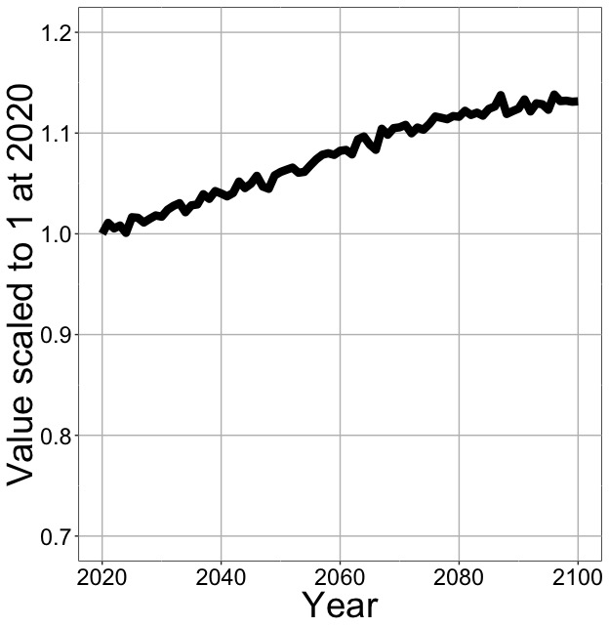
Photosynthesis increases in future
nick.smith@ttu.edu; @nick_greg_smith
Net Photosynthesis
Smith et al. (in prep)

Slide 78
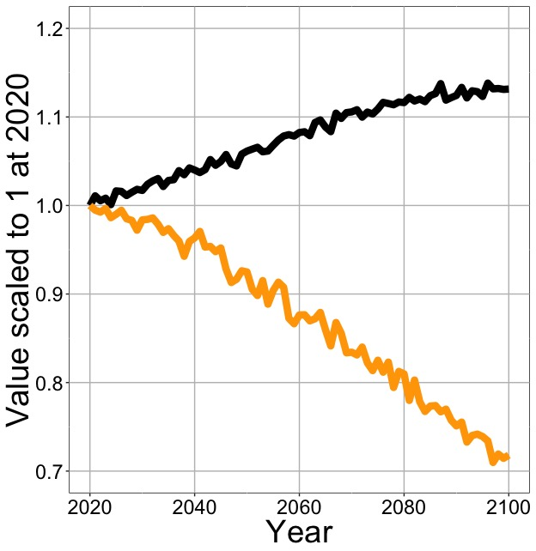
Photosynthesis increases in future (at lower nutrient use)
nick.smith@ttu.edu; @nick_greg_smith
Net Photosynthesis
Leaf Nitrogen
Smith et al. (in prep)

Slide 79
Need to rethink nutrient limitation in models?
“No limitation” simulation
“Nutrient limitation” simulations
Weider et al. (2015)

Slide 80
Question 3: What does acclimation mean for future terrestrial biogeochemical cycling? Photosynthesis will increase and per-leaf-area nutrient use will decrease
nick.smith@ttu.edu; @nick_greg_smith

Slide 81
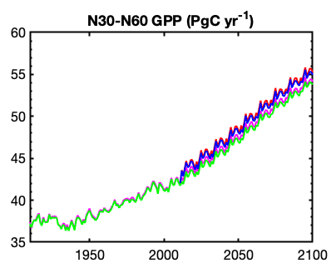
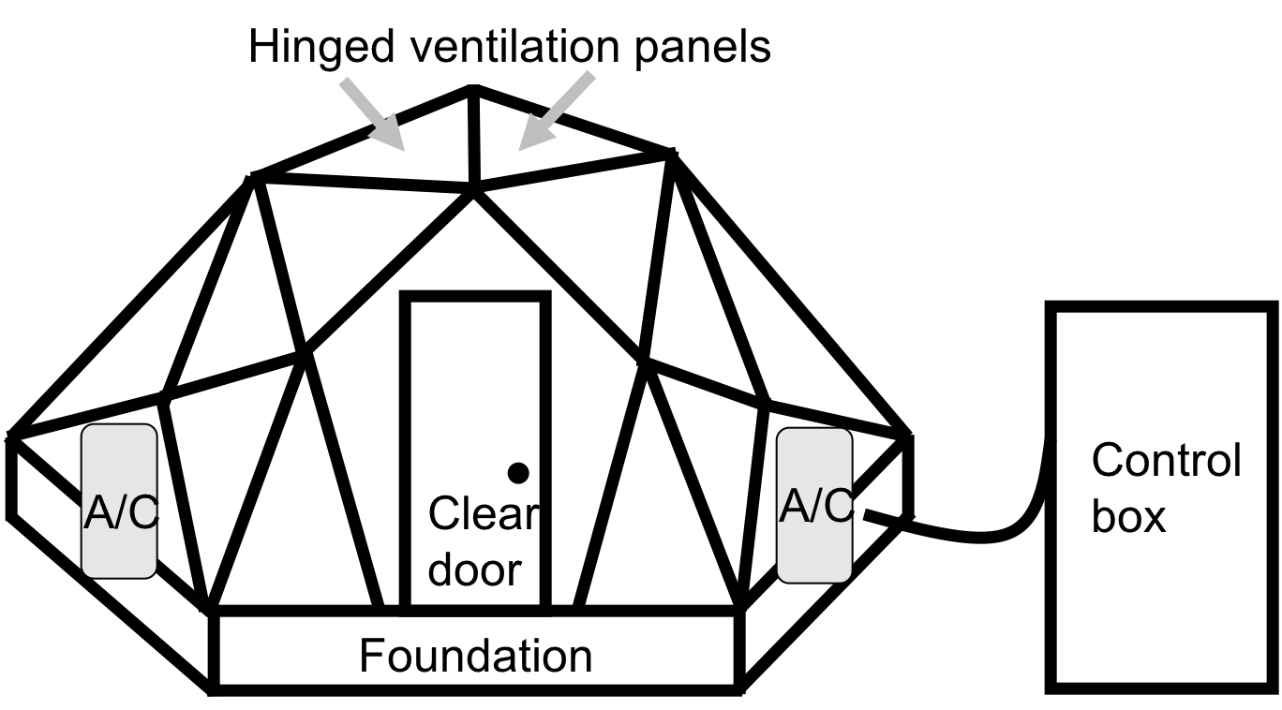
Looking forward: role of acclimation on future ecosystem feedbacks
nick.smith@ttu.edu; @nick_greg_smith
Coupled model-data experiments

Slide 82
Question 4: When is C₄ photosynthesis an advantage over C₃ photosynthesis?
nick.smith@ttu.edu; @nick_greg_smith

Slide 83
C₃ versus C₄ optimization
nick.smith@ttu.edu; @nick_greg_smith

Slide 84
C₄ versus C₃ optimization
nick.smith@ttu.edu; @nick_greg_smith
C₄ photosynthesis has…
No photorespiration
An additional limitation (PEP carboxylation)

Slide 85
C₄ versus C₃ optimization
nick.smith@ttu.edu; @nick_greg_smith
C₄ photosynthesis has…
No photorespiration
An additional limitation (PEP carboxylation)

Slide 86
nick.smith@ttu.edu; @nick_greg_smith
Relative advantage of C₄ physiology
Scott and Smith (in review)

Slide 87
nick.smith@ttu.edu; @nick_greg_smith
Relative advantage of C₄ physiology
Scott and Smith (in review)

Slide 88
nick.smith@ttu.edu; @nick_greg_smith
Relative advantage of C₄ physiology
Scott and Smith (in review)

Slide 89
nick.smith@ttu.edu; @nick_greg_smith
Relative advantage of C₄ physiology
Scott and Smith (in review)

Slide 90
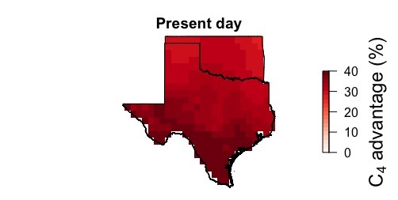
nick.smith@ttu.edu; @nick_greg_smith
Ansley et al. (in prep)

Slide 91
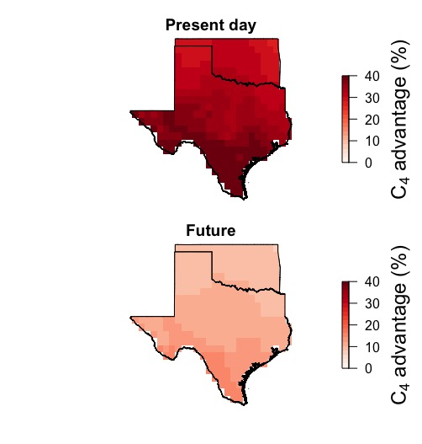
nick.smith@ttu.edu; @nick_greg_smith
Ansley et al. (in prep)

Slide 92
Question 4: When is C₄ photosynthesis an advantage over C₃ photosynthesis? C₄ is better in hot, dry, low CO₂ environments
nick.smith@ttu.edu; @nick_greg_smith

Slide 93
Looking forward: model-data comparisons for C₄ plants
nick.smith@ttu.edu; @nick_greg_smith

Slide 94
Conclusions
nick.smith@ttu.edu; @nick_greg_smith

Slide 95
Conclusions
nick.smith@ttu.edu; @nick_greg_smith
Plants aren’t dumb!
Assuming plants don’t dynamically respond to their environment can lead to poor understanding of ecosystem functioning
Dumb plants

Slide 96
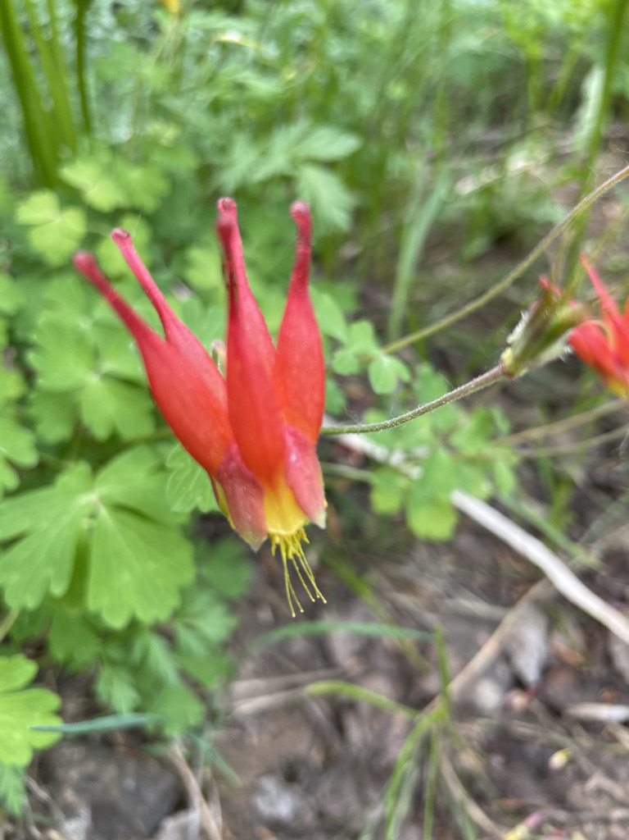
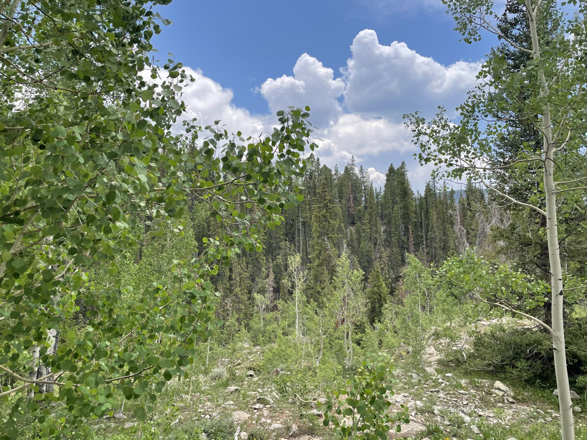
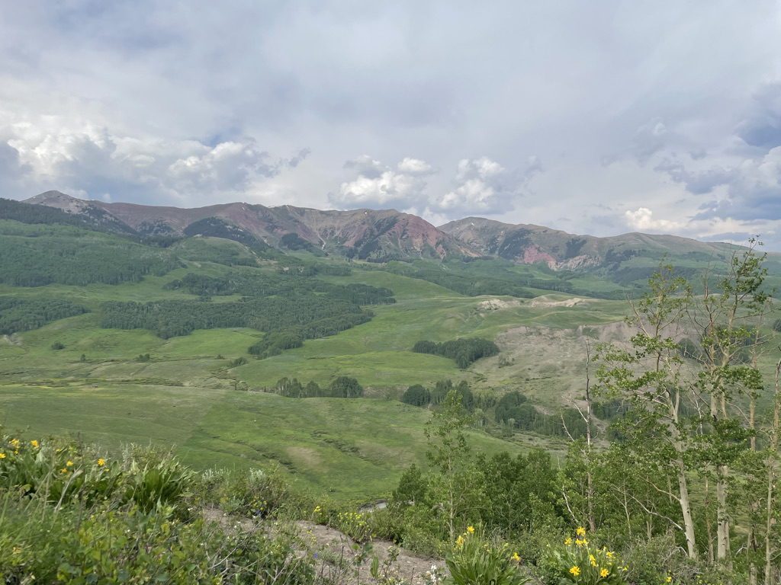
Conclusions
nick.smith@ttu.edu; @nick_greg_smith
Quantified physiological theory can:
Improve mechanistic understanding of physiological processes that underlie higher level responses
Produce more reliable future projections
f(x)
f(x)

Slide 97
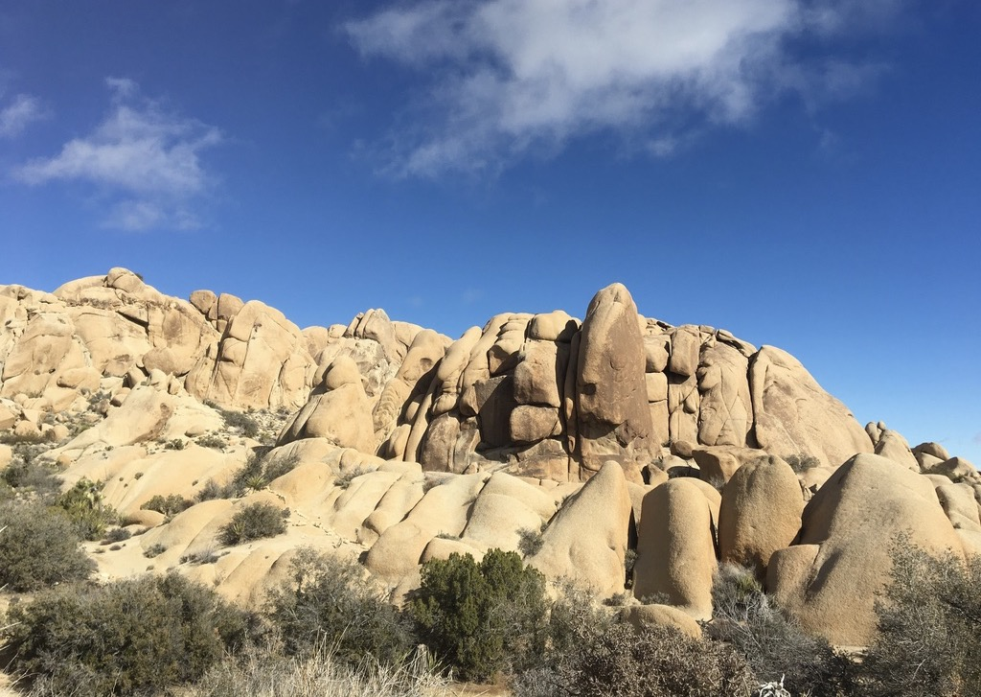
nick.smith@ttu.edu; @nick_greg_smith
Presentation available at:
www.github.com/SmithEcophysLab/seminar/2021_michigan
Thanks!

Slide 98
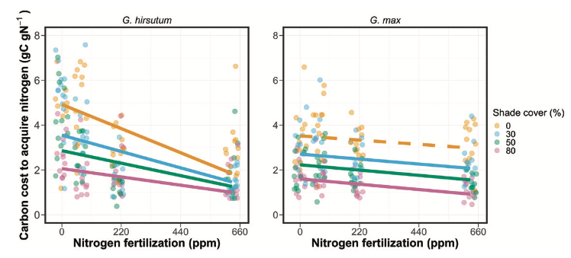
Looking forward: symbioses as modifiers of plant economies under variable conditions
nick.smith@ttu.edu; @nick_greg_smith
Soybean (right panel) economics are much less responsive to soil nitrogen than cotton (left panel)
Perkowski et al. (2021)

Slide 99
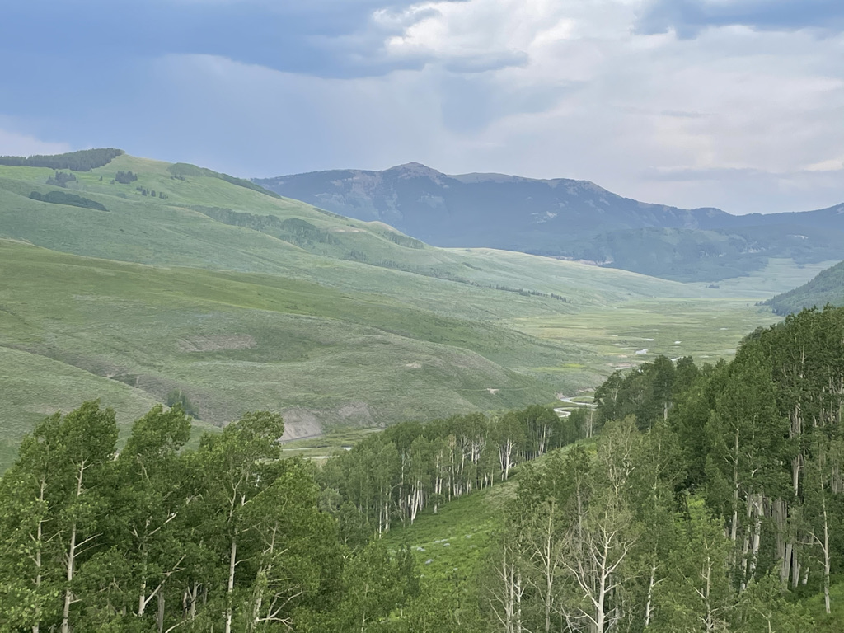
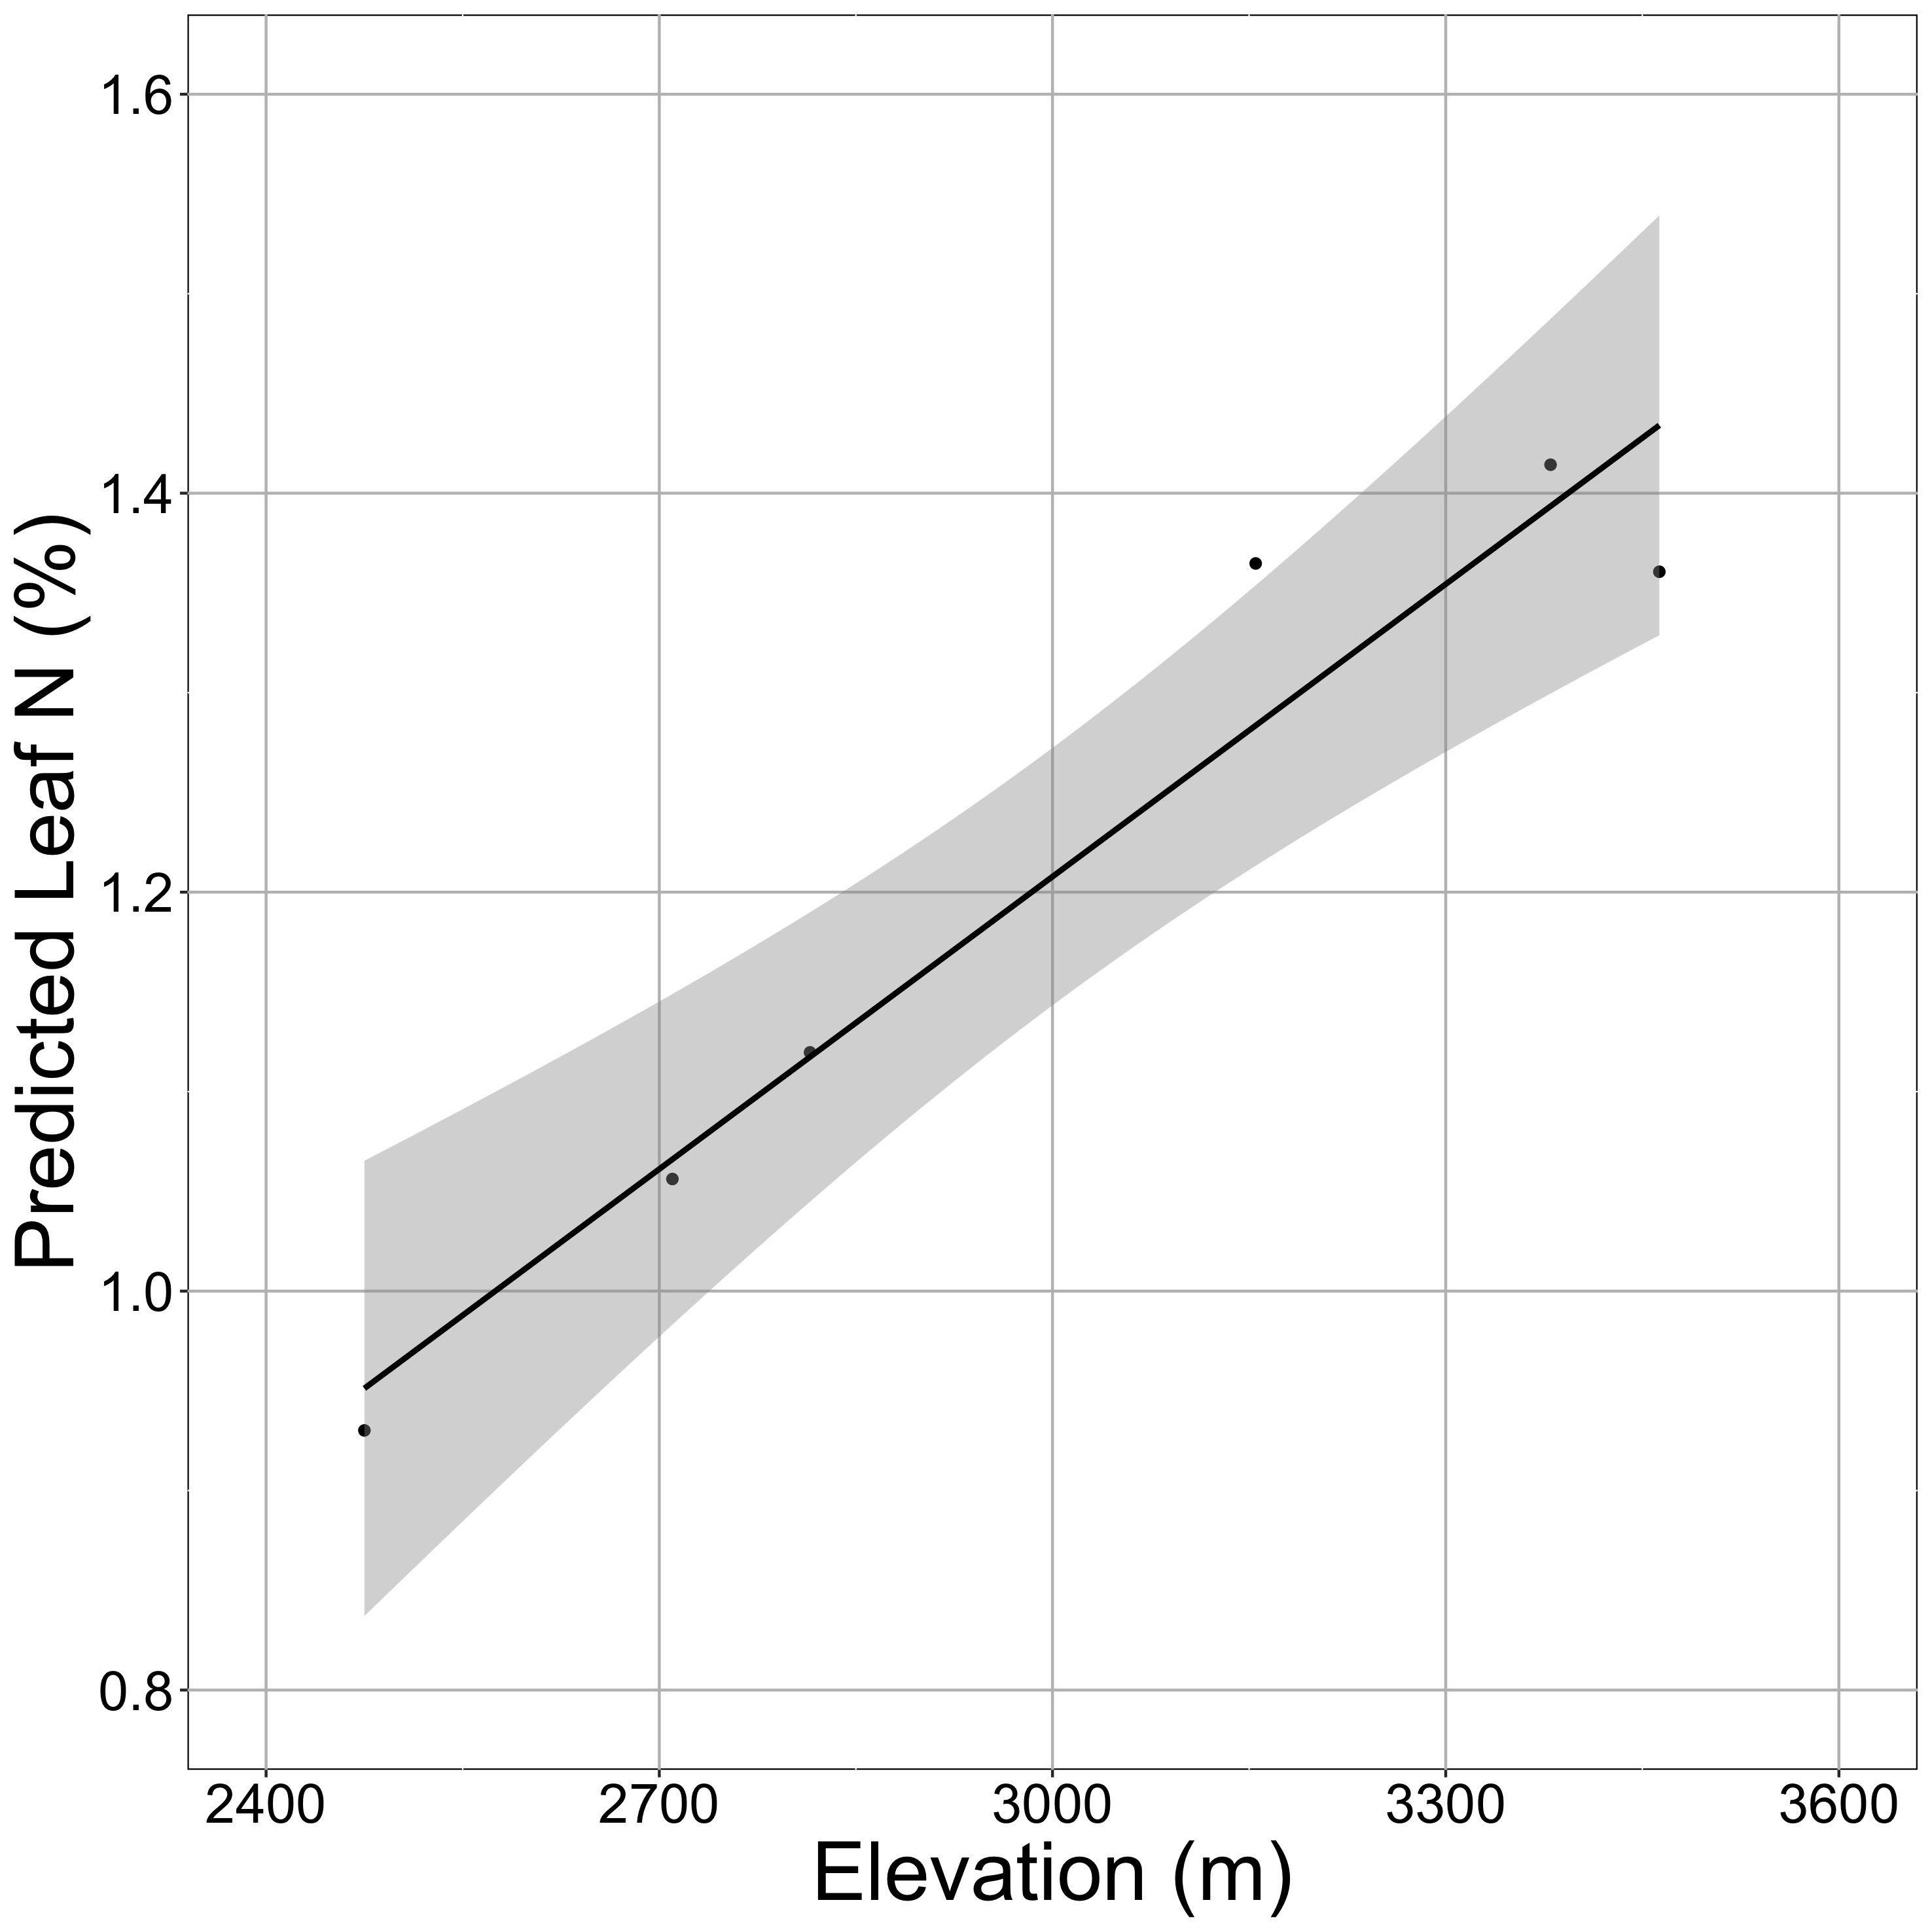
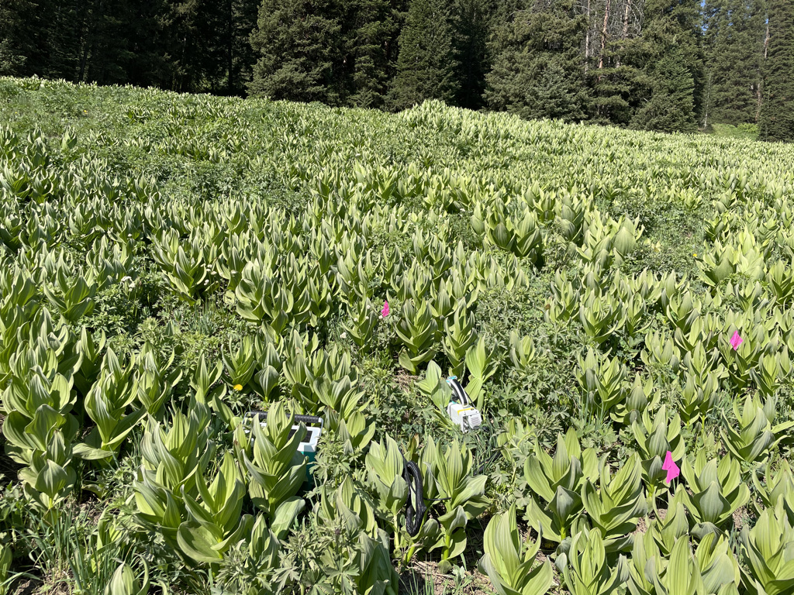

Looking forward: more acclimation predictions in more places to examine larger scale impacts
nick.smith@ttu.edu; @nick_greg_smith

Slide 100


Looking forward: other ongoing and future research
nick.smith@ttu.edu; @nick_greg_smith
Land management modifications of plant-atmosphere feedbacks
Cover crop implementation increases latent heat flux (left) and albedo (right) as compared to fallow fields.
McNellis et al. (in review)

Slide 101
nick.smith@ttu.edu; @nick_greg_smith
Open stomata:
Benefits
High CO₂ influx
Costs
High water outflux
Closed stomata:
Benefits
Low water outflux
Costs
Low CO₂ influx

Slide 102
nick.smith@ttu.edu; @nick_greg_smith
Open stomata:
Benefits
High CO₂ influx
Costs
High water outflux
Closed stomata:
Benefits
Low water outflux
Costs
Low CO₂ influx
Must maintain high amount of Rubisco to do photosynthesis

Slide 103
Optimal stomatal conductance
nick.smith@ttu.edu; @nick_greg_smith
Optimal conductance maximizes photosynthesis at least water loss and nutrient use
Water loss is from transpiration
Nutrient use is nutrients used to maintain Rubisco
[TALK TO ME LATER ABOUT THE MATHS]

Slide 104
Stomatal conductance trait The ratio of CO₂ in the leaf to CO₂ outside of the leaf (C_{i}/C_{a})

Slide 105

nick.smith@ttu.edu; @nick_greg_smith
C_{i}/C_{a} increases with temperature because of greater photorespiration
Smith et al. (2019)

Slide 106

nick.smith@ttu.edu; @nick_greg_smith
C_{i}/C_{a} decreases with VPD to avoid water loss
Smith et al. (2019)

Slide 107

nick.smith@ttu.edu; @nick_greg_smith
C_{i}/C_{a} decreases with CO₂ because of lower openness needed to satisfy Rubisco
Smith et al. (2019)

